Slide 1


Wearable Sensors for Gait Recognition and Analysis
Adane Nega Tarekegn
The Software, Data and Digital Environments (SDDE) Research Group
Department of Computer Science,
NTNU - Norwegian University of Science and Technology

Slide 2
Contents of the Presentation
AlAMEDA Project
Overview and Rational
NTNU Role in the Project
Smart Belt Data Collection Service
Gait Recognition and Analysis
Work in Progress

Slide 3
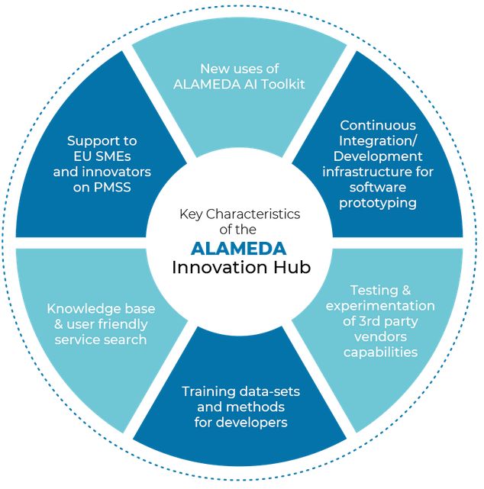
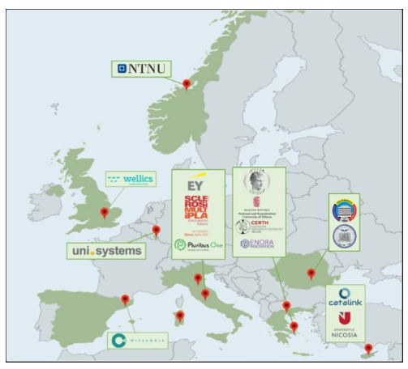
ALAMEDA Project: Overview
Bridging the Early Diagnosis and Treatment Gap of Brain Diseases via Smart, Connected Proactive, and Evidence-based Technological Interventions
Goal: To research and prototype the next generation of personalized AI healthcare support systems for people with brain diseases and disorders, specifically focusing on the needs of Parkinson’s, Multiple Sclerosis (MS), and Stroke (PMSS) patients’ rehabilitation treatments.
Consortium of 15 expert organizations from 8 countries
Total Work Packages (WP): 9
NTNU is leading and contributing WP4
January 2021-December 2023
Notes:
It is a collaborative project from different countries in Europe
The consortium is well-balanced in terms of involvement from the ICT industry, academia, and research as well as public and non-profit organizations.

Slide 4
Rational for ALAMEDA Project
Better care for patients with brain disorders
Brain disorders are complex, and manifestations of certain diseases could worsen over time and seriously impair the quality of life of patients.
Using AI, the project aims to provide personalized rehabilitation treatment assessments for patients with Parkinson’s, Multiple Sclerosis, and Stroke
AI methods and Big Data Management as predictive tools
better tools for assisting the detection of early signs of brain disease are needed.
The cost savings that AI can bring to the healthcare system, and the timely treatment and rehabilitation of disease conditions, are important drivers for AI applications.
Impact on health systems, economies, and societies
There is a global problem of healthcare workforce shortage→ deficit of 4.1 million skilled health professionals, by 2030.
Digital Transformation is a challenging necessity
Prevalence of most neurological disorders increases with age, and their burden is expected to rise in countries with aging populations.
It is believed that AI-powered solutions can address the challenges
Notes:
Better care for patients with brain disorders
Using Artificial Intelligence (AI) healthcare support systems, the project aims to provide personalized rehabilitation treatment assessments for patients with Parkinson’s, Multiple Sclerosis, and Stroke, to prevent high-risk situations at an early stage.
AI methods and Big Data Management as predictive tools
The use of AI methods (Big Data Analytics, Machine, and Deep Learning) as predictive tools is particularly relevant for brain diseases as the outcomes are essentially irreversible. In this light, better tools for assisting the detection of early signs of brain disease are needed.
Direct costs of brain disorders make up for 60% of the total costs, surpassing other diseases, such as cardiovascular diseases, brain diseases, and diabetes together.
Impact on health systems, economies, and societies
Digital Transformation is a challenging necessity due to the global problem of healthcare workforce shortage that is believed to reach a deficit of about 4.1 million skilled healthcare professionals (midwives, nurses, and physicians) by 2030 in the EU, according to the World Health Organization. This will create a huge gap in healthcare operations and services. AI can complement medical recommendations and foster higher efficiency and effectiveness of treatments in areas where there is a shortage of professionals.
Prevalence of most neurological disorders increases with age, and their burden is expected to rise in countries with aging populations.
Brain disorders are the most problematic expression of elderly people.
ALAMEDA acknowledges the importance of AI-powered solutions to address all these challenges related to Brain diseases.

Slide 5
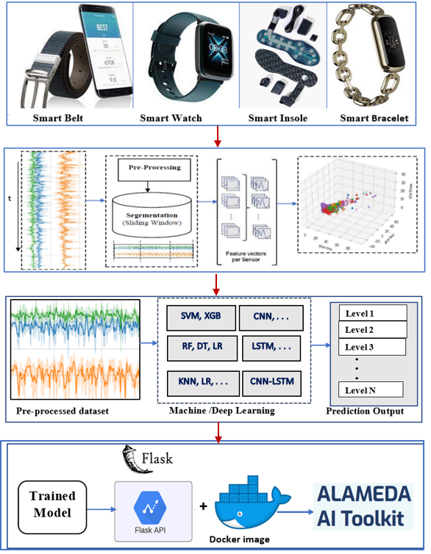
NTNU Role in ALAMEDA: Data Analytics, Machine/Deep Learning
Data Collection Service using sensors
Smart Belt Sensors at NTNU
Data Annotation Preporcessing
WP4
Data Analytics
Machine/Deep Learning
GA AI Toolkit
FER AI Toolkit
Dockerization and Integration of Toolkits
Notes:
NTNU is responsible for these tasks :
Data Collection using sensors: ALAMEDA involves the Collection of data from Pilots sites where data is collected on real patients with brain diseases, such as : PD, stroke, MS,
For these task, different sensors ( such as smart belt, smart watch, smart insoles and smart bracelet) are used from different partners.
NTNU is also responsible for producing and delivering smart belt sensor for data Collection in the Project.
We are also responsible for data annotation, preprocessing and analytics using of the data generated from ALAMEDA project,
Develop models using ML and Deep learning . Until now we have already developed and submitted two AI toolkits, namely Gait Analsysis toolkit and Facial emotion recogntion toolkits.
The toolkits tested locally with dockerization for integration in the project.

Slide 6
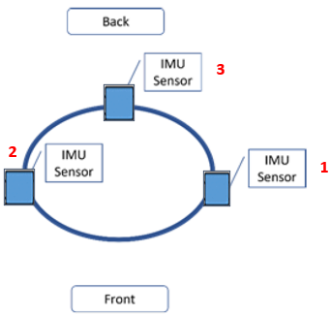
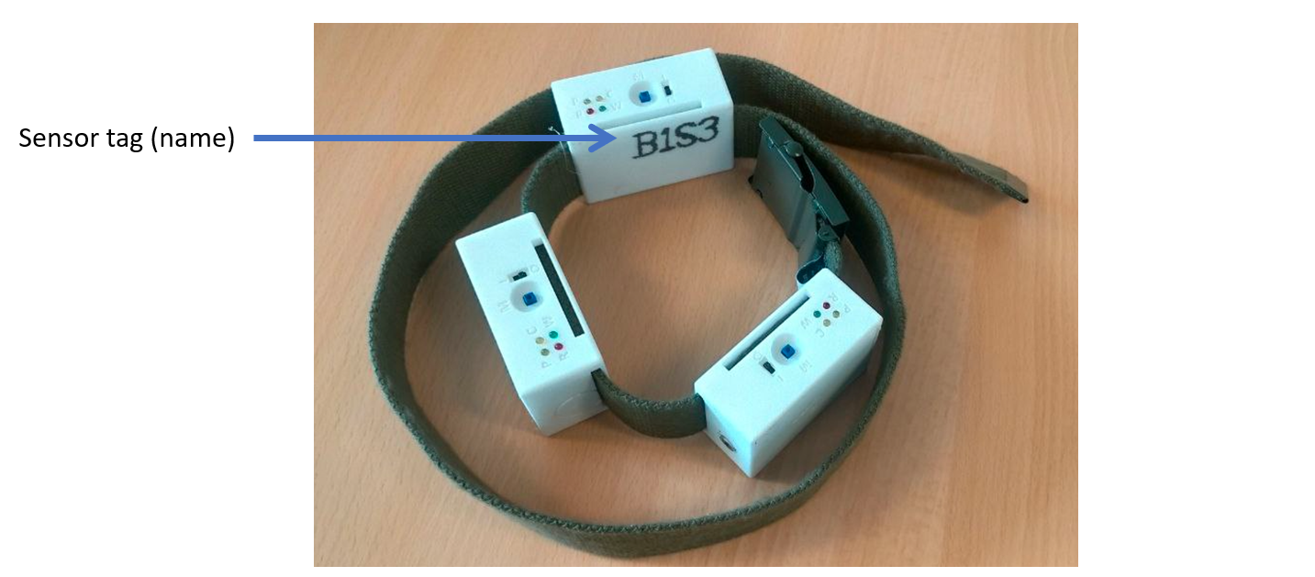
Smart Belt Data Collection Service
NTNU team designed and developed smart belt sensors for data collection
It is composed of three motion tracking sensors:
Two mounted on the left and right side of the waist on the belt.
Third sensor is mounted on the belt at the lower back of the body
User manual/demo are prepared: descriptions and configuration of the device.
Notes:
To be used in different pilots of the project : Greec (PD), Romania (Stroke) and Italy (MS)
Until now about 9 sensors have already sent to the pilots and they are being used for data collection
The sensors are primarly used for recording patients motion activity, such as to
Detection of daily living activities (ADLs)
Control patients with motion impairments
Aiming at detection of freezing of gait (FOG), tremor, bradykinesia through assessing the quality of the patient’s walk from gait metrics such as speed, symmetry, balance, etc.
Rehabilitation process of Stroke and MS.

Slide 7
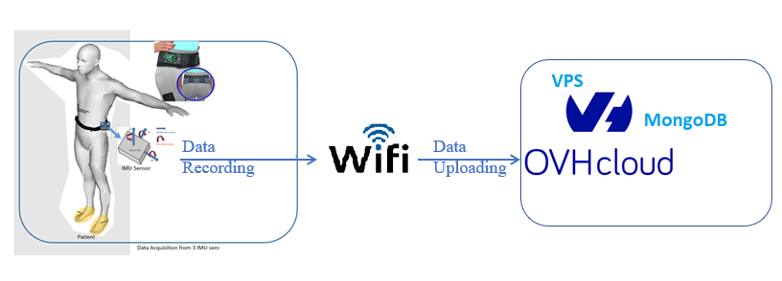
Data Recording and Storage
Sensors record motion activities of patients with PD, Stroke, and MS.
PD: health monitoring, such as detecting freezing of gait (FOG), tremor, bradykinesia
Stroke: to improve the capacity to predict functional independence after a stroke
MS: to predict the risk of developing a relapse in MS
Each sensor in three positions on the belt generate 3D
Acceleration data, i.e. Ax, Ay, and Az
Gyroscope data, i.e. Gx, Gy, and Gz
The recorded data is uploaded and stored in a cloud
Notes:
PD is a complex and progressive brain disorder, which is characterized by a combination of motor symptoms such as bradykinesia, resting tremor, rigidity, and non-motor symptoms, such as psychiatric disorders, pain, and fatigue
The disease is typically diagnosed based on clinical symptoms, related mainly to motor functions such as tremors and rigidity
However, motor symptoms tend to appear several years after the onset of the disease, leading to a late diagnosis.
Stroke is a sudden, local disturbance of blood circulation in the brain.
MS is a chronic inflammatory and neurodegenerative disease that can affect the central nervous system, leading to irreversible neurological damage, such as disability, sleep problems, and long-term functional impairment.
MongoDB is a NoSQL database program that uses JSON-like documents with optional schemas.

Slide 8
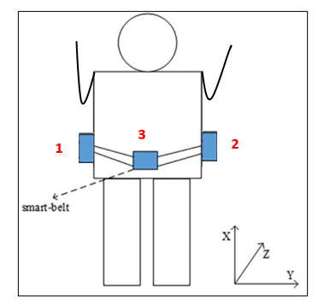
Data Collection using Smart Belt at NTNU
Before shipment of sensors to the pilot sites
Sensors are tested
Data Collection performed locally (NTNU Gjøvik)
3 IMU (inertial measurement unit) sensors were used; mounted on the waist.
12 healthy participants were involved based on some predefined protocols
Detect activity of daily living (ADLs):
Static activities: sitting, laying, and standing
Dynamic activities: Walking, downstairs and upstairs
Each sensor records 3 linear and 3 angular accelerations at 100Hz.

Slide 9
Gait Recognition and Analysis
Gait impairment is one of the most common manifestations of PD
Today, PD is assessed through clinical examinations, evaluating the quality of visual moments, and providing a symptom score, such as UPDRS
Prone to subjectivity, inter-rater variability, and time-consuming
Gait Analysis (GA) using wearable sensors is an inexpensive method
Automatic evaluation of PD symptoms, such as to estimate UPDRS scores or detect motor symptoms
Wearable-based GA can provide useful information for health-related applications.
Gait Analyzer apps: FOG detection and prevent the risk of falls in people with PD
Stimulates the patients to resume walking by providing a rhythmic auditory signal.
Notes:
PD is typically diagnosed based on clinical symptoms, related mainly to motor functions such as tremors, rigidity, and bradykinesia (slowness of movement)
However, motor symptoms tend to appear several years after the onset of the disease, leading to a late diagnosis.
FOG/Falls are a leading cause of injury among older adults and most often occur during walking and stair negotiation
For example, healthcare apps have been developed in recent years to detect freezing of gait and prevent the risk of falls in people with Parkinson’s disease, whereby the app continuously monitors the movement and helps patients to coordinate their gait by providing a rhythmic auditory simulation
Falls and FOGs may happen at walking, downstairs, or during transitional activities (sit-stand, lying-to stand, etc)
Mobile apps have been developed to detect freezing of gait and prevent the risk of falls in people with Parkinson’s disease, whereby the app monitors the patients’ movement and help stimulates the patients to resume walking by providing a rhythmic auditory signal
By auditory cueing, I refer to the process whereby movement is synchronized to sound. Auditory cues can guide movement through their temporal structure to which movement can be aligned. Several systematic reviews have shown that cueing has an immediate and sustained effect on gait and reduces the severity of freezing of gait.

Slide 10
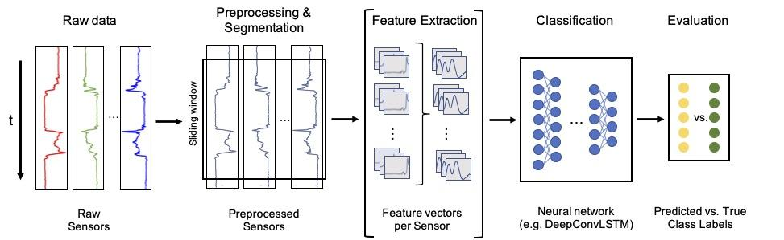
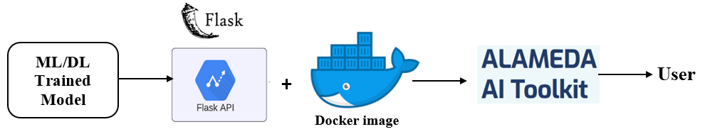
Data Analytics – Typical Pipeline for GA
Notes:
ALAMEDA could greatly reduce the cost and burden of healthcare systems by demonstrating AI-enabled prediction, prevention, and intervention, making the treatment of disorders: Specifically focusing on Parkinson’s diseases (PD), multiple sclerosis (MS), and Stroke.

Slide 11
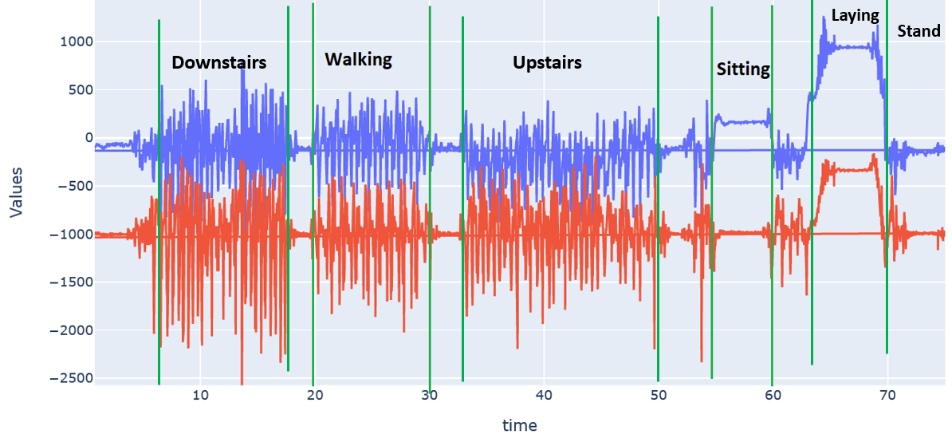
Data Annotation
NOVA: https://github.com/hcmlab/nova
Python Graphical Tools
Notes:
Data annotation is one of the main challenge in HAR . Becuase every data point needs a label.
In normal circumstances , annotationa should be done automatically using software application
However, annotation was done manually using annotation tool, named NOVA in conjunction with Python graphical tools

Slide 12
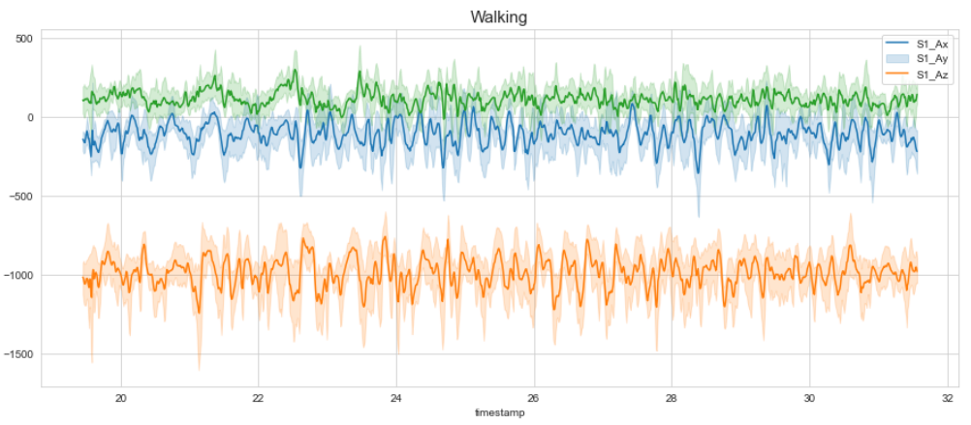
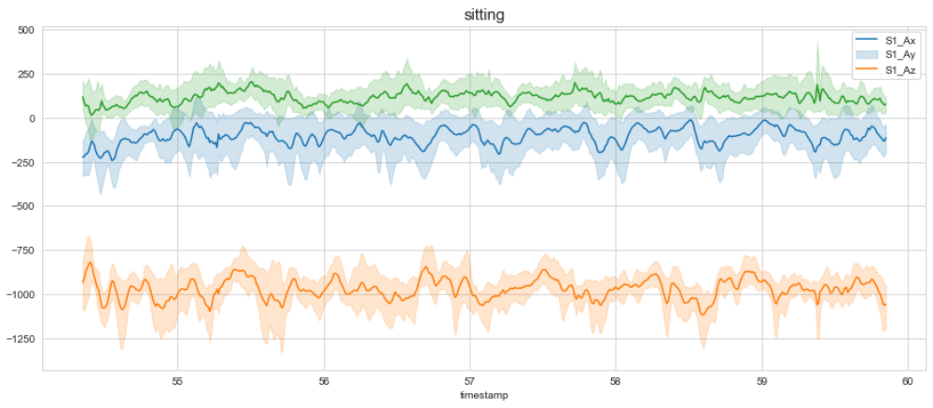
Data Annotation Visualization
Notes:
Data annotation is one of the main challenge in HAR . Becuase every data point needs a label.
In normal circumstances , annotationa should be done automatically using software application
However, annotation was done manually using
annotation tool, named NOVA in conjunction with Python graphical tools

Slide 13
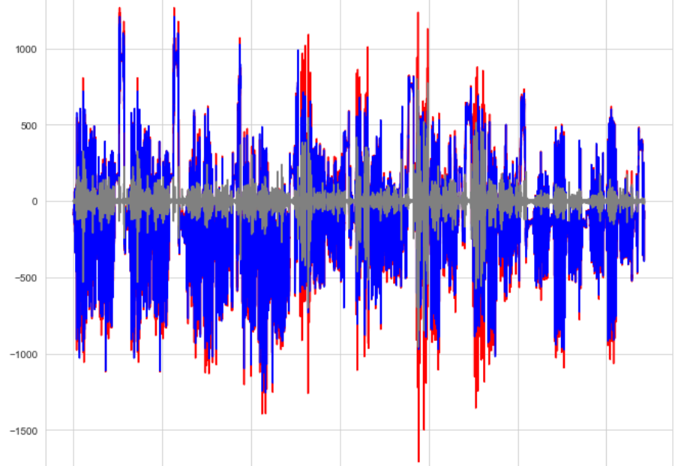

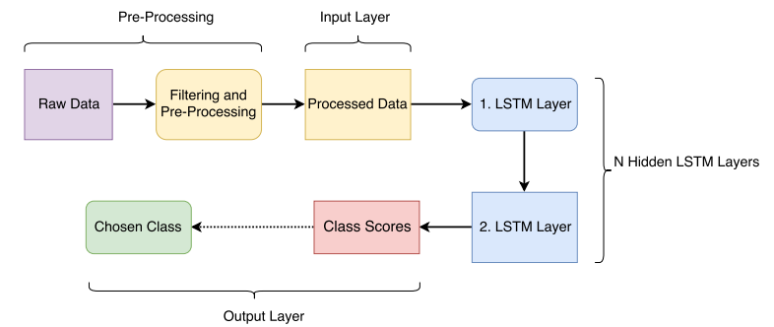
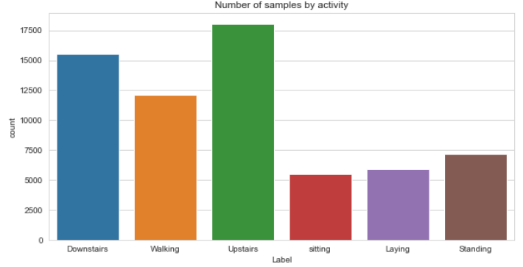
Data Cleaning, Preprocessing and Analytics
Data Cleaning
Missing values
Check for duplicates
Check for outliers
Noise Filtering
Data Preprocessing
Normalization
Data transformation
Feature extraction
Dimensionality reduction
Predictive Analysis
Machine Learning
Deep learning
Analysis of results
Interpretation
Notes:
One of the issues in activity recognition, and gait in particular, is that often datasets are unbalanced (i.e., the distribution of classes is not uniform)
Most HAR methodologies consist of four stages: data acquisition, data pre-processing, feature extraction, and activity classification

Slide 14
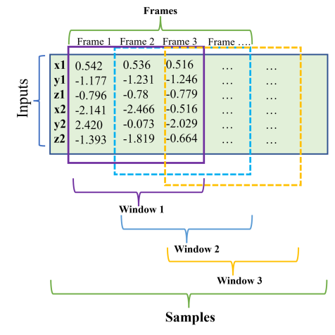
Data Transformation
Sliding Window: dividing sensor signals into smaller time segments.
Sampling frequency 100Hz.
Each segment:
a window length of 2.5 seconds (250 samples)
an overlap of 0.5 seconds (50 samples).
A window was labeled by the most frequent occurring activity
Sequences of sensor data (Acc and Gyro)
Overlap
Notes:
After Annotations, Noise filtering, Normalization, etc. , we did windowing
Why sliding winodw?
To extract features from raw data, and classification algorithms are then applied respectively to each window.
The sliding window approach is well-suited to real-time applications.

Slide 15
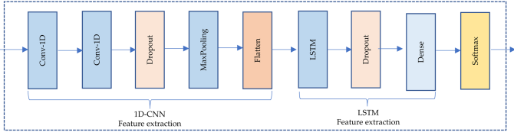
Feature Extraction
Handcrafted features: Conventional ML techniques
Time domain features : mean, median, variance, skewness.
Frequency domain features : Peak frequency, peak power, entropy, etc.
Automatic Features : Deep learning
Spatiotemporal features: CNN & LSTM
Notes:
Human activity recognition from inertial data is generally preceded by a feature extraction step.
Handcrafting features : both time domain and frequency domain features were extracted
Deep learning features: spatio temporal features (CNN) and temporal features (LSTM) were automatically extracted.
Fourier Transform (FT) is used to compute frequency spectrum of the signal.
CNN extracts spatial features, and pass the sequence to LSTM for temporal features

Slide 16
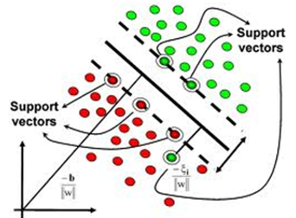
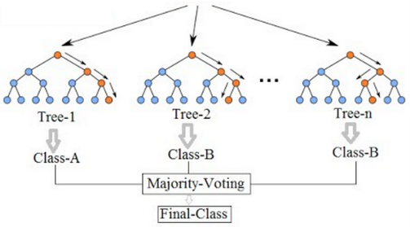
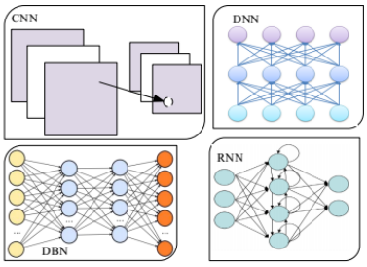
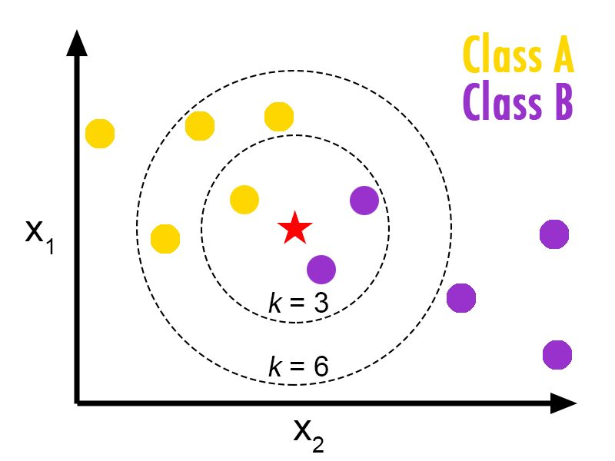

Machine/Deep learning
Support Vector Machine (SVM)
Random Forest (RF)
Deep Learning
KNN Classifier

Slide 17
Validation and Testing
Common practice in ML/DL: Training, Validation, and Testing
Full Dataset
Training Data
60%
Validation Data
20%
Testing Data
20%
For model building
For model tuning
For Final evaluation

Slide 18
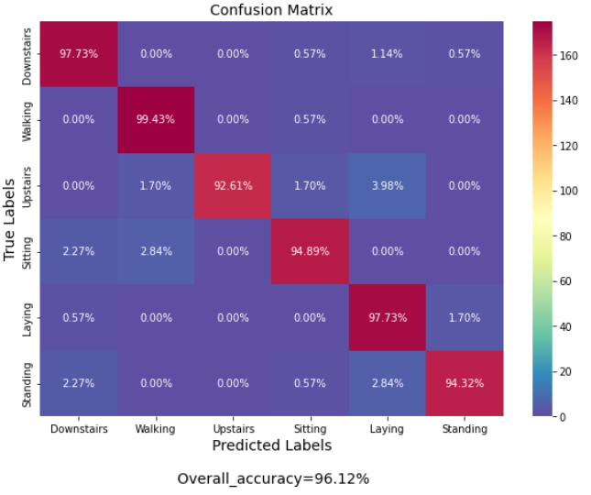
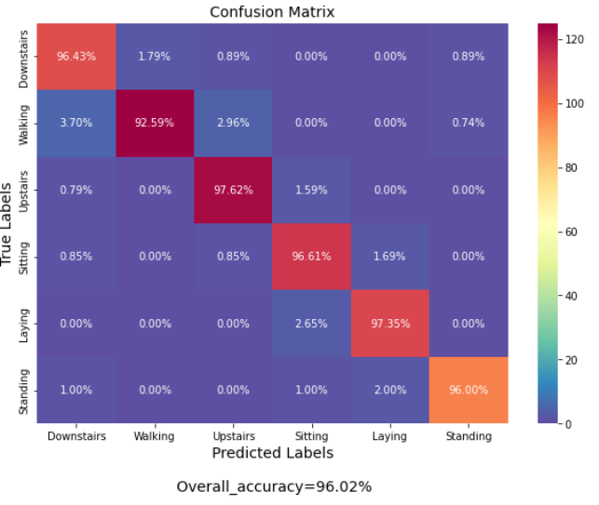
Confusion Matrix
RF
1D CNN-LSTM
Synthetic Minority over sampling
Notes:
The activities are correctly classified with accuracy greater than 90%
Overall accuracy is 96%.
RF has the most difficulty in distinguishing the ‘upstairs’ activity from the ‘Walking’ activity, in which around 1.70% of the samples are wrongly classified as ‘Walking’ activity.
CNN-LSTM has the most difficulty in distinguishing the ‘Walking’ activity from the ‘downstairs’ and ‘upstairs’ activity, in which around 1.70% of the samples are wrongly classified as ‘Walking’ activity.

Slide 19
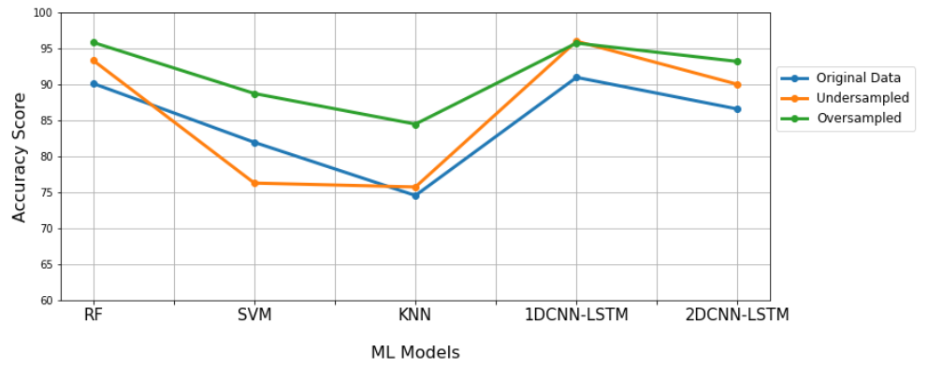
Accuracy on Testing Dataset
A window length of 2.5 Seconds
Notes:
One of the issues in activity recognition, and gait in particular, is that often datasets are unbalanced (i.e., the distribution of classes is not uniform)

Slide 20
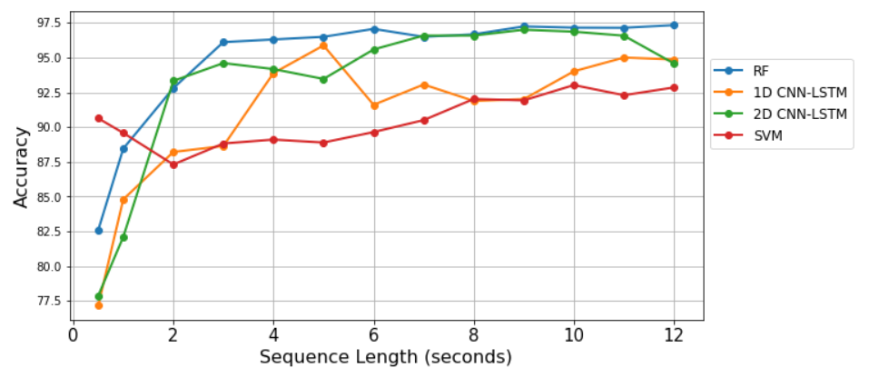
Effect of Sequence Length on Performance
Notes:
In our experiment, we also examined the influence of increasing window sequence length on the performance of the action recognition model.
In the previous literature, it has been shown that a window size of 2s is sufficient for recognizing the most common daily human activities, such as walking, jogging, sitting, and standing.
However, we realize that a small window size may be insufficient to recognize the patterns of human activity.
As we can see that accuracy is constantly increasing until 6s. After the sequence length of 6s, the performance becomes stagnant and starts decreasing for 2D CNN-LSTM.
Generally, we realize enhanced recognition performance is likely achieved as the size of the window increases

Slide 21
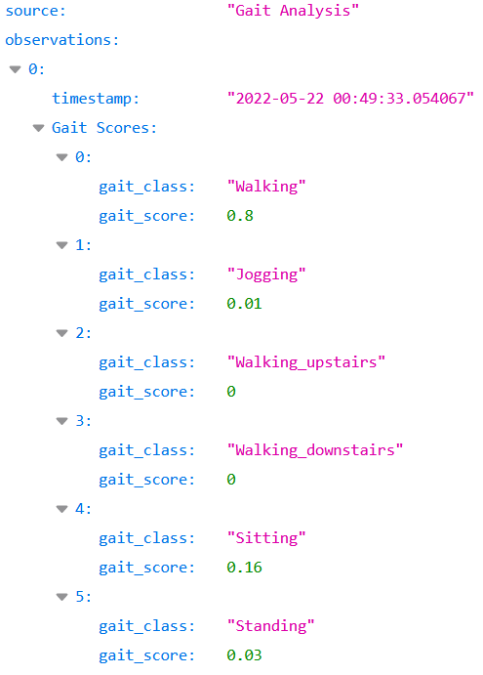
Outputs in JSON format (RF)
The output of the prediction consists of gait class scores for each class.
JSON format containing the probability estimation of each class.

Slide 22
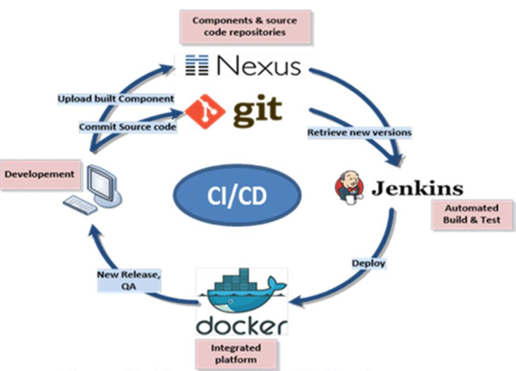
Integration of GA Component
ALAMEDA proposed CI/ CD infrastructure.
Continuous integration and development
for automated build and testing
CI/CD infrastructure Contains
GitLab for source control and Code Repository
Docker for containerization of services
Docker Registry for easy deployment at different pilot sites’ infrastructures.
Notes:
The problem:
Because the project involves collaboration between multidisciplinary teams (data scientists, AI engineers, software and apps developers, and other staff)
Along with the use of different platforms, datasets, and programming languages (python, Java, etc, )
All these must be integrated and tested using a Git-based CI/CD pipeline to make it to production/deployment.
A framework that leverages cloud-native paradigms, Git, and Kubernetes to automate the process of ML/AI-based application deployment.
Avoids the issue that most AI projects never make it to production.
A continuous integration and continuous deployment (CI/CD) pipeline is a series of steps that facilitates the software delivery process from source to production.
Jenkins - a continuous integration (CI) platform.
Nexus - a repository manager.

Slide 23
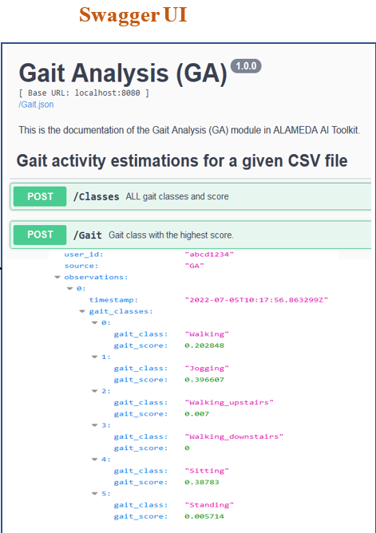
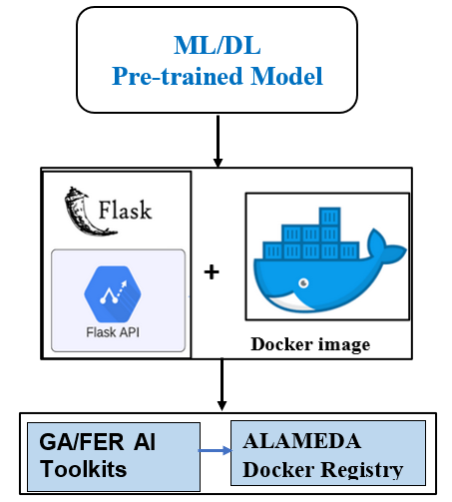
Integration of GA Component
Demo
Test
Notes:
Our pretrained model is deployed as REST API using the Flask server ( a framework for web development in python).
Then, the whole module is contained in a docker image and tested using the Swagger user interface.
This docker image is pushed into the docker registry of the project to be used by other components in the project.

Slide 24
Work in Progress
Smart Belt Sensor Hardware
Modification of size/usability of sensors
User interface for data acquisition
Identifying the optimal sensor position for accurate recognition of the activities.
Gait-based PD severity prediction
Characterization of activities from more specific gait parameters such as stride lengths, step lengths, cadence, etc.
Analyze the speed, balance, symmetry, or stride-to-stride variability
Freezing of gait (FOG) detection and fall prevention for people with PD
Publications
Journal Paper on Gait Recognition and Analysis
Survey paper on Gait analysis for Parkinson’s diseases
Notes:
Wearable sensor placement has a direct effect on the measurement of bodily motions, but the ideal sensor location for particular applications is still a subject of much debate.

Slide 25
Thank you!
Questions?

